Slide 1

Health Insurance Prediction
Data Glacier Data Science Project

Slide 2
Health Insurance
Factors that can affect a health insurance plan's monthly premium: location, age, tobacco use, if you are smoker, plan category, and whether the plan covers dependents. Notice: FYI Your health, medical history, or gender can't affect your premium.

Slide 3
Dataset: insurance.csv
This dataset has 4 different areas, 2 genders, children from 1 to 5, weather a person is a smoker, and some other factors which are not that important and do not make a different in the insurance prices.

Slide 4

Average Price in different location
This shows that the location do make a minor change in the health insurance price, but this is strictly based on the analysis of this dataset.
Northwest: 12417
Southwest: 12346
Northeast: 13406
Southeast: 14735

Slide 5
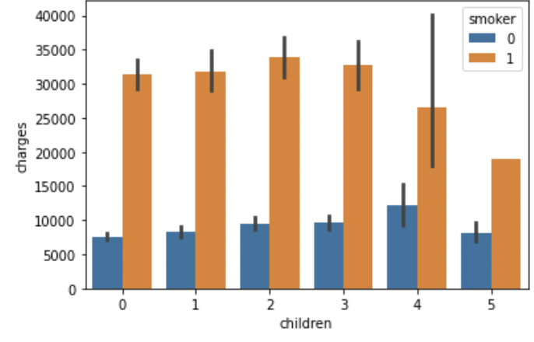
Average Price with someone with children with hue of smoker
This clearly shows that the person might have different number of children, but the price has minor amount of variance due to that, but there is some difference in location, which also brings some minor change. The hue in this chart makes a huge difference, which we will talk about in the next slide.

Slide 6
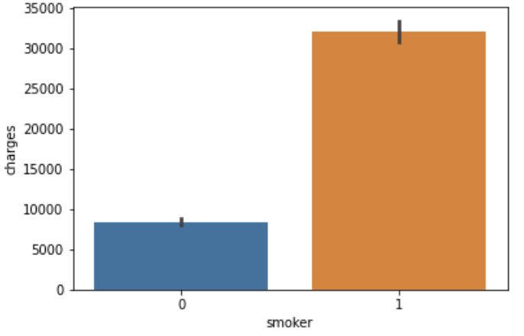
Average Price if smoker or no
This chart clearly shows that if the person ticks smoking on their chart, there is a huge difference in the health insurance price.

